Slide 1
ATM SYSTEM (DEV C++)
GROUP MEMBERS
ABIDA BIBI
HARIS AMIN
SAMIK HUZBAN
PRESENTED TO
SIR ABDULLAH MANSOOR
LAHORE GARRISION UNIVERSITY
IT DEPARTMENT

Slide 2
CONTENTS
Introduction
Working
Check Balance
Withdraw Amount
Deposit Amount
Exit Program
Conclusion

Slide 3
INTRODUCTION
The ATM system is the project which is used to access bank accounts in order to make cash withdrawals.
Whenever the user need to make cash withdraws, they can enter their PIN.
Then system displays some options, Check Balance, Withdraw Amount, Deposit Amount and Exit Program.
ATM enables the clients of a bank to have access to their account without going to the bank.

Slide 4
WORKING
It is an electronic device that is used by only bank customers to process account transactions.
The users access their accounts through a special type of plastic card that is encoded with user information on a magnetic strip.
The strip contains an identification code that is transmitted to the bank’s central computer by modem.
The users insert the card into ATMs to access the account and process their account transactions.

Slide 5
TECHNIQUES USED IN PROJECT
We have use “if-else-if” statement in this project.
We have also use ‘escape sequences’ to display the output in the middle of the screen, e.g., \n and \t.
ATM system is developed using C++ Programming Language.

Slide 6
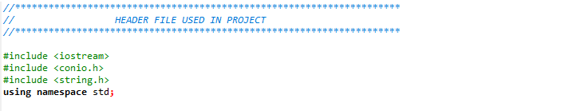
HEADER FILES

Slide 7
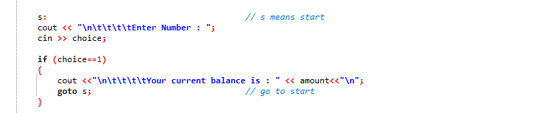
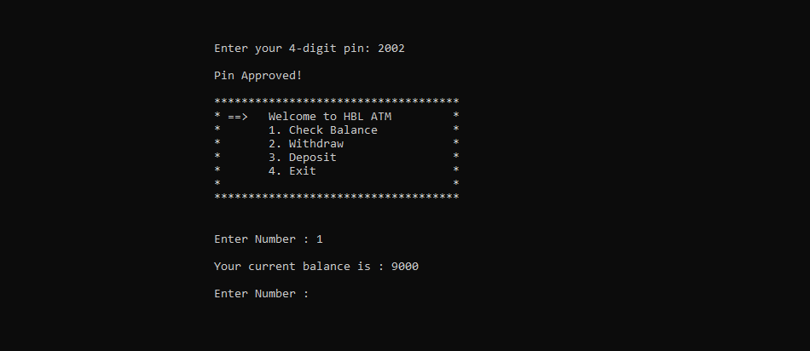
CHECK BALANCE
Code:
Output:

Slide 8
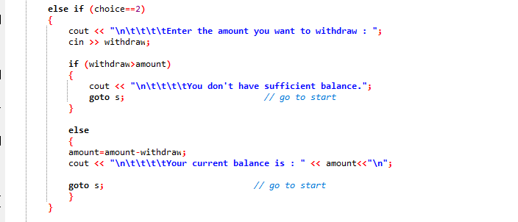
WITHDRAW AMOUNT
Code:

Slide 9
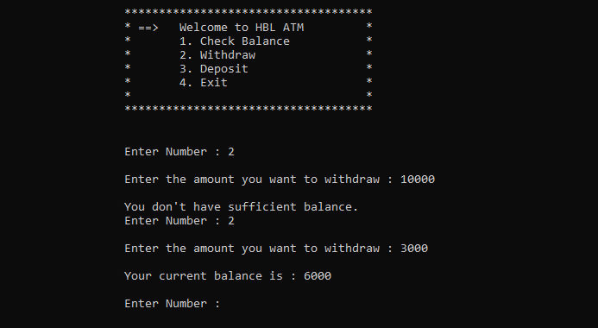
WITHDRAW AMOUNT
Output:

Slide 10
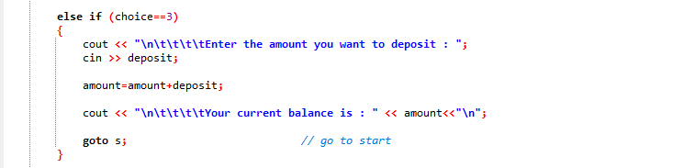
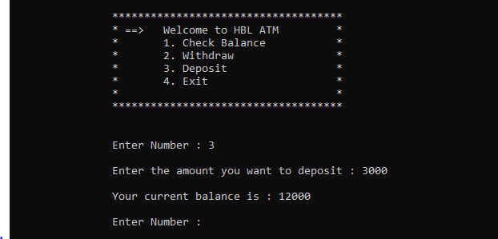
DEPOSIT AMOUNT
Code:
Output:

Slide 11
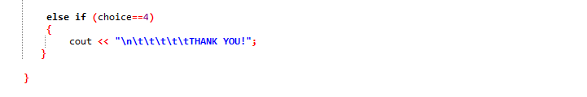
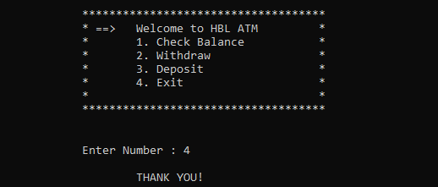
EXIT PROGRAM
Code:
Output:

Slide 12
CONCLUSION
This mini Project contains fewer features but the essential ones.
The system is designed to provide the user with the facility of remote banking and perform various other functions at an interface without any aid of human bank teller.
It is a fast way to get money out of your account, especially when on the go or during a trip.

Slide 13


